Slide 1

RL Lecture 1: Introduction to Reinforcement learning
Michael Melnik
mihail.melnik.ifmo@gmail.com

Slide 2
Plan
All main things you need to now to work on RL tasks
Easy theory, main concept
Implement DQN and PPO algorithms in pytorch
How to use popular frameworks (rllib, sb3)
How to design RL environment
How to analyse results and how to tune
Exploration \ exploitation
Unity MLAgents

Slide 3
For today:
1. Introduction to Reinforcement Learning
- Base definition and problem statement
- Main training \ play loop
- Examples
- Overview of algorithms taxonomy
2. Deep Q Network (DQN) algorithm
- of-policy methods
- implementation from scratch
- experiments with classic toy problems
- analyse performance and training results
- neural network structure

Slide 4
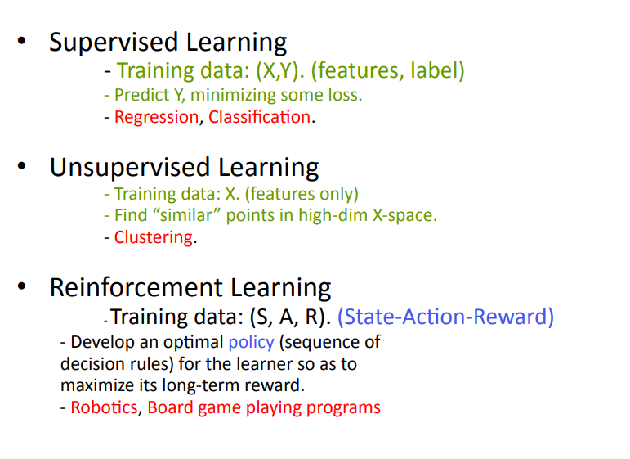
What is RL

Slide 5
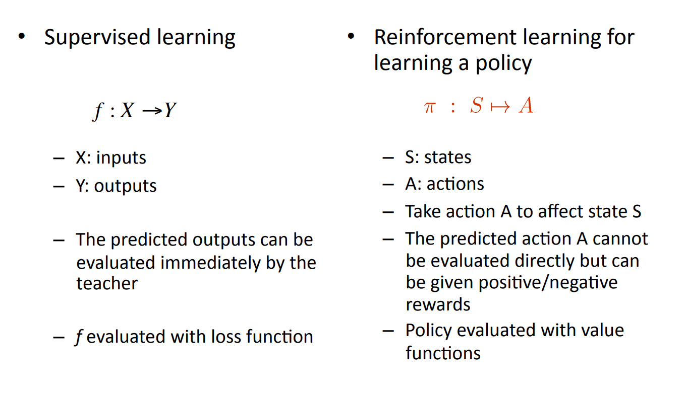
Difference to Supervised learning

Slide 6
RL and MDP
Reinforcement learning is actually based on Markov Decision Process

Slide 7
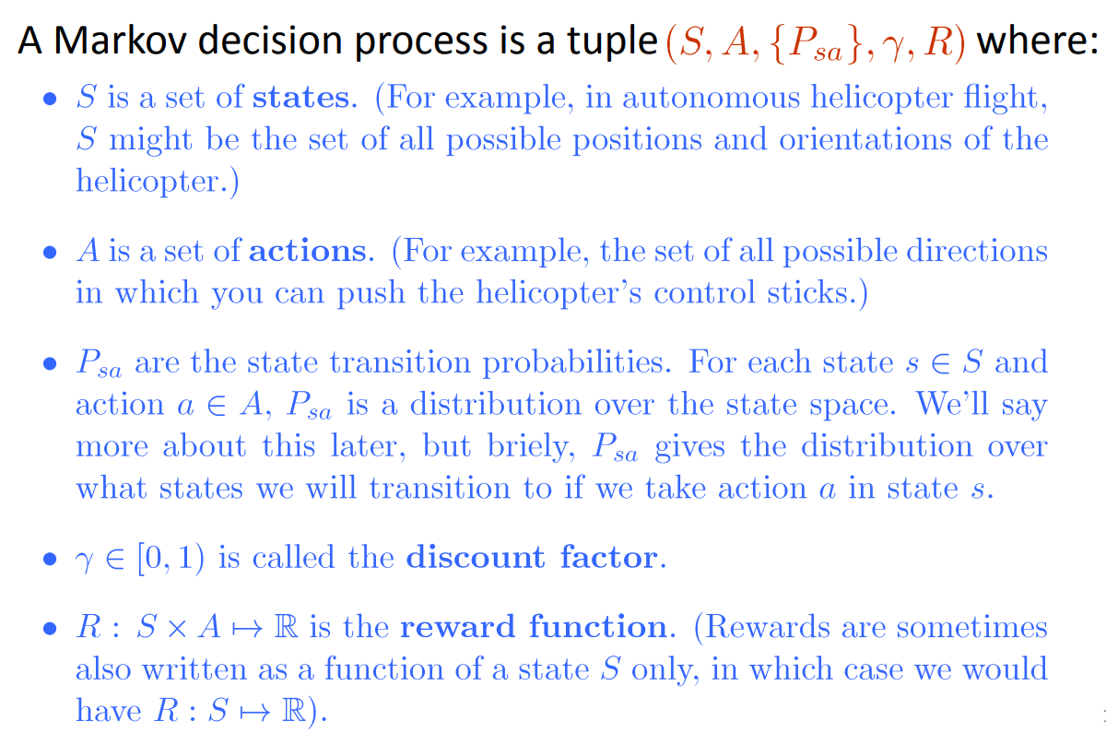
Markov Decision Process (MDP)

Slide 8
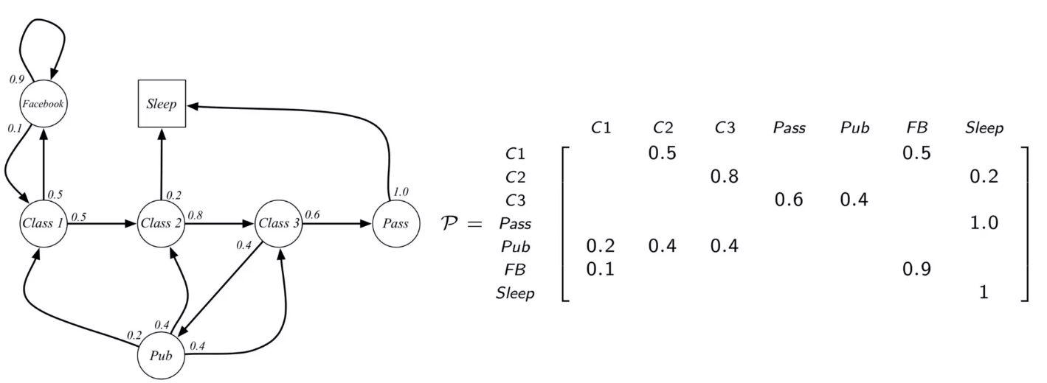
MDP example

Slide 9
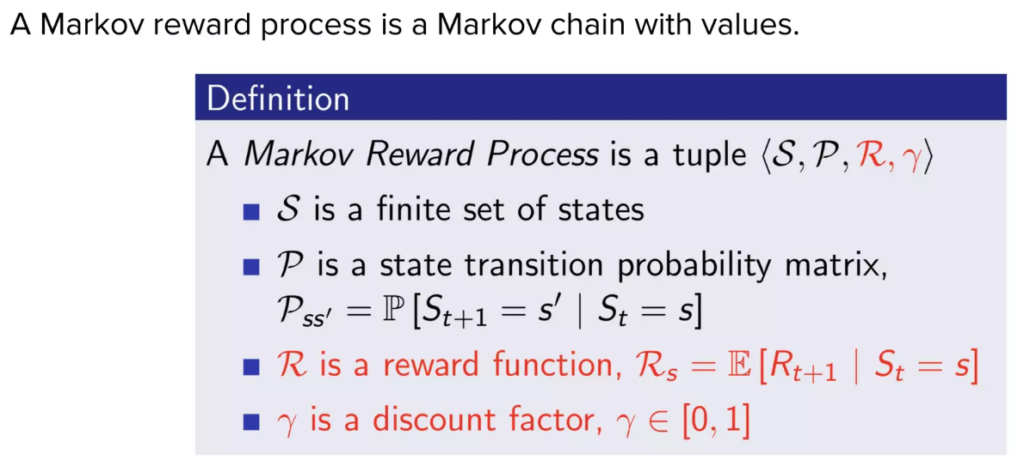
Markov Reward Process

Slide 10
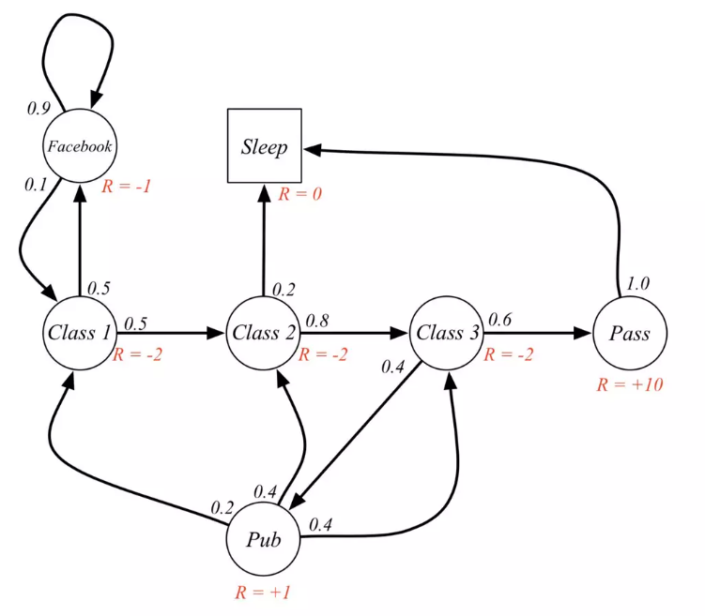
Markov Reward Process example

Slide 11
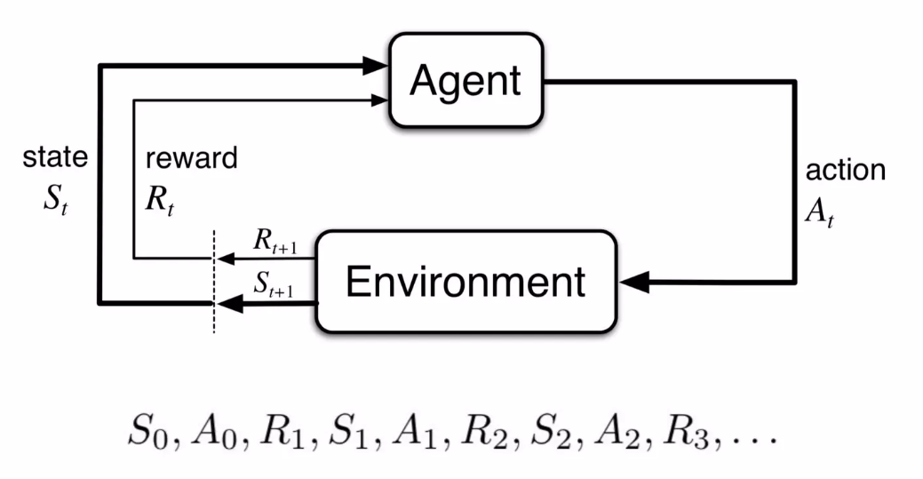
RL loop
Loop

Slide 12
Gym
Gym.Env
Interface:
def reset()
# returns obs
def step(action: ActType)
# returns (obs, reward, done, info)
Optional:
def render(mode="human")

Slide 13
Gymnasium (actual)
Gymnasium.Env
Interface:
def reset()
# returns (obs, info)
def step(action: ActType)
# returns (obs, reward, done, trunc, info)
Optional:
def render(mode="human")

Slide 14
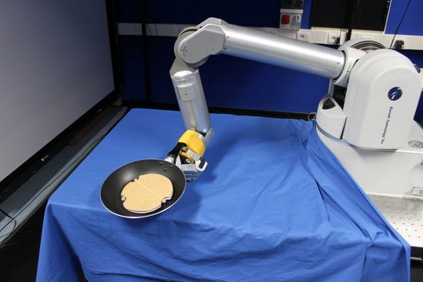
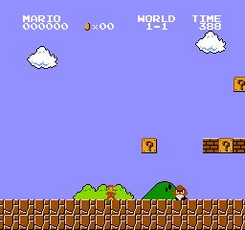
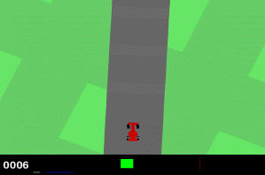
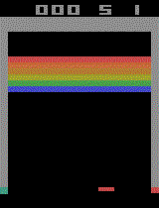
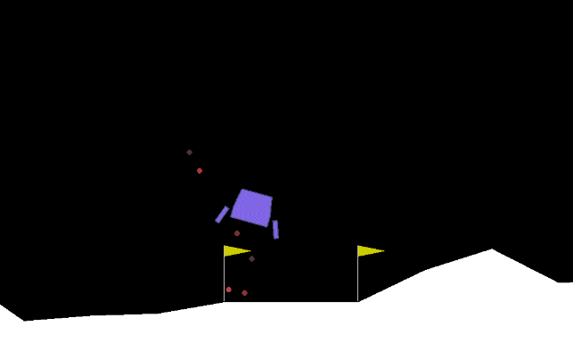
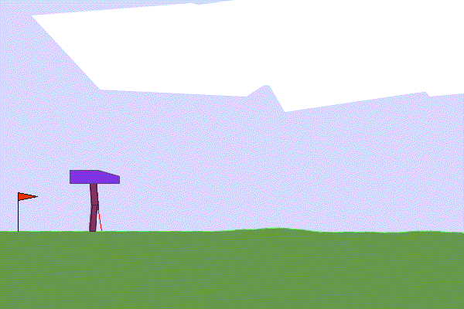
Examples
Gym - main API for RL environments
https://www.gymlibrary.dev/index.html
Robotics
Language models
Physics simulations
Logistics …

Slide 15
Training loop
Iteration over episodes:
state = env.reset()
score = 0
Iterate over steps: action = agent(state)
next_state, reward, done = env.step(action)
score += reward
if done -> break
agent.learn()

Slide 16
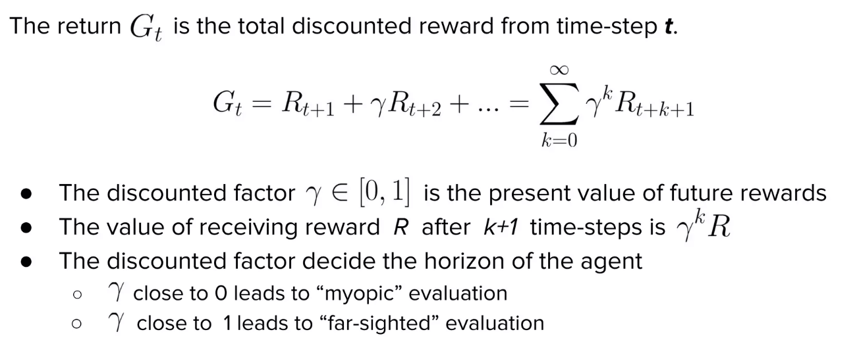
Return

Slide 17
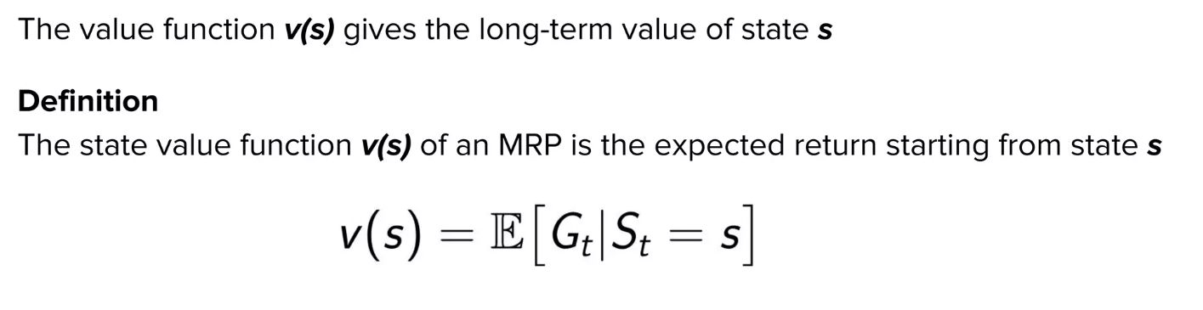
Value function

Slide 18
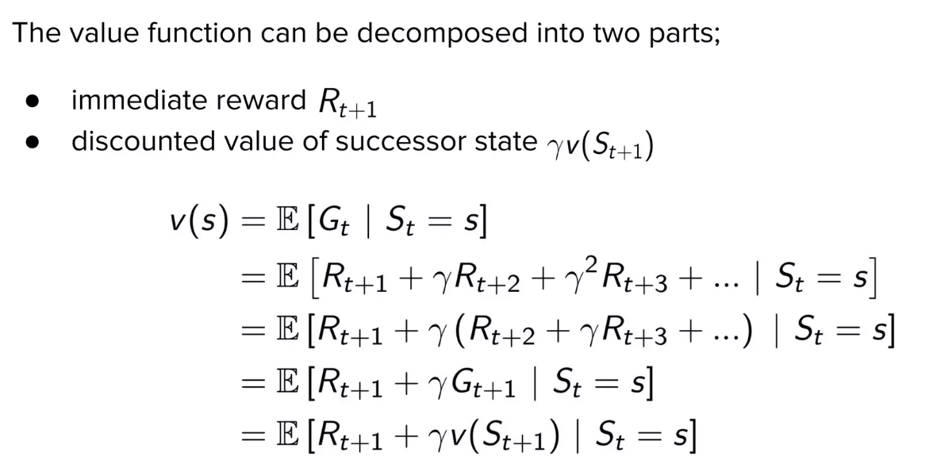
Value function

Slide 19
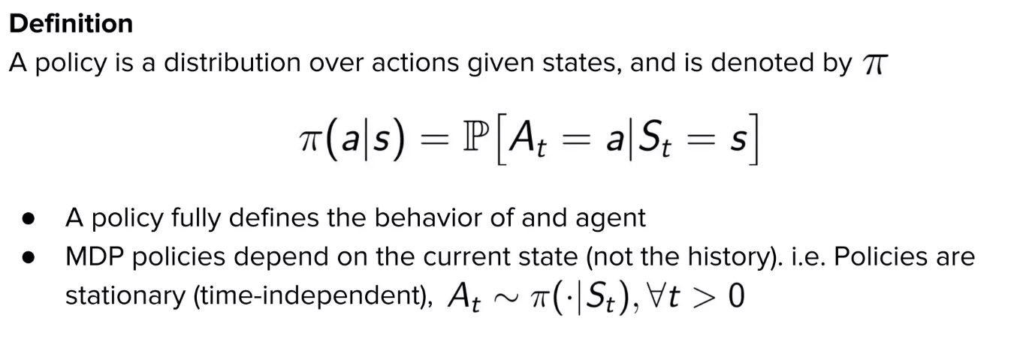
Policy

Slide 20
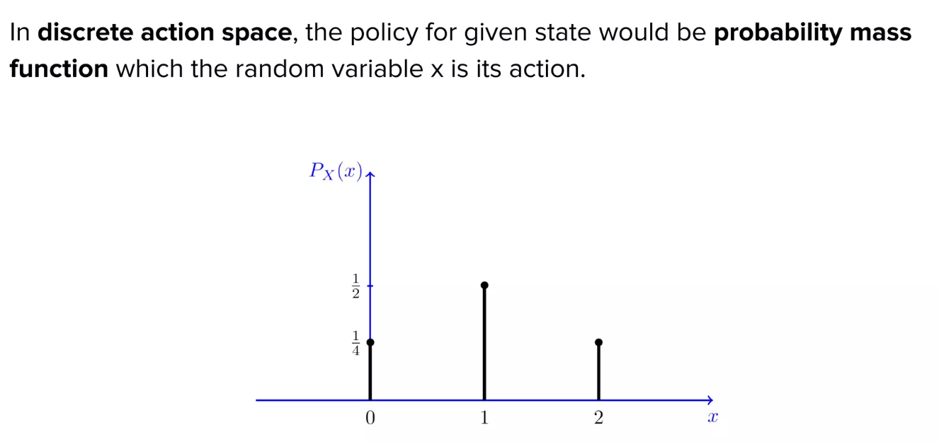
Policy discrete actions

Slide 21
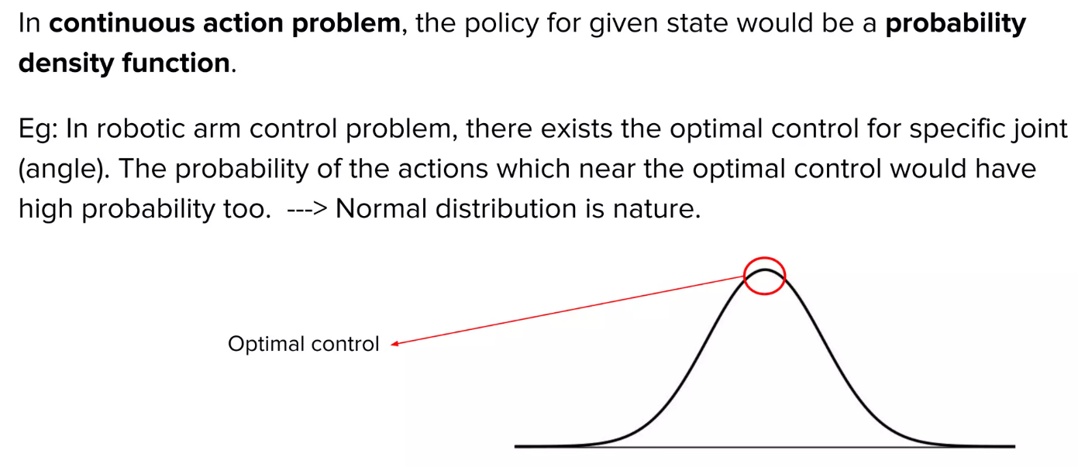
Continuous actions

Slide 22
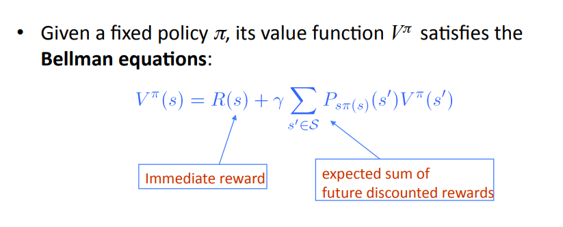
Bellman Equation

Slide 23
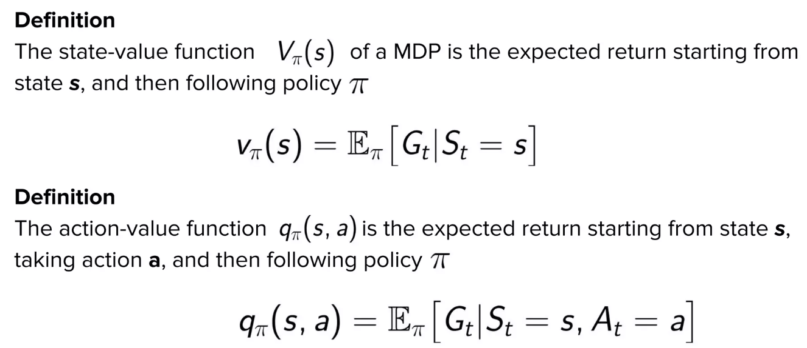
Q function

Slide 24
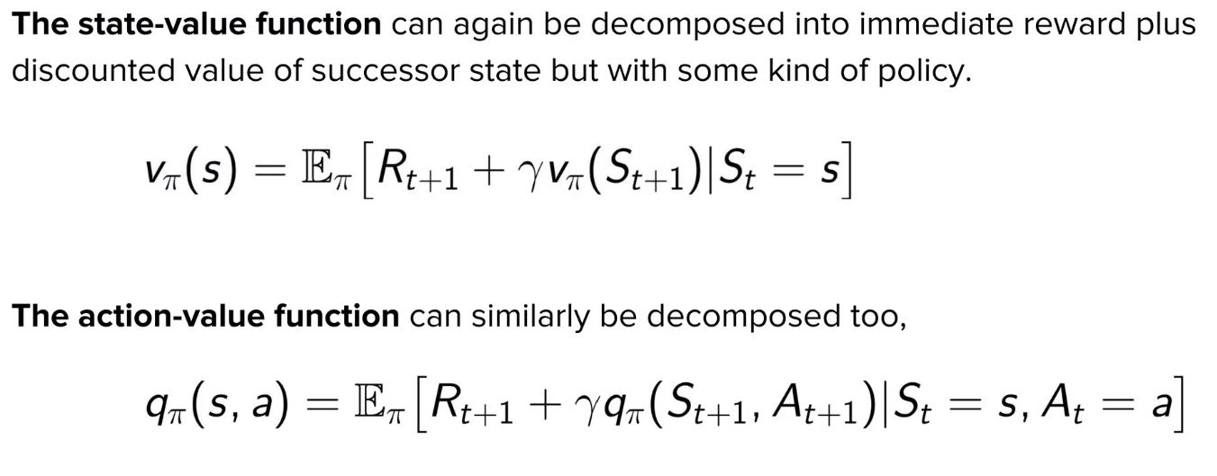
Bellman Equation

Slide 25
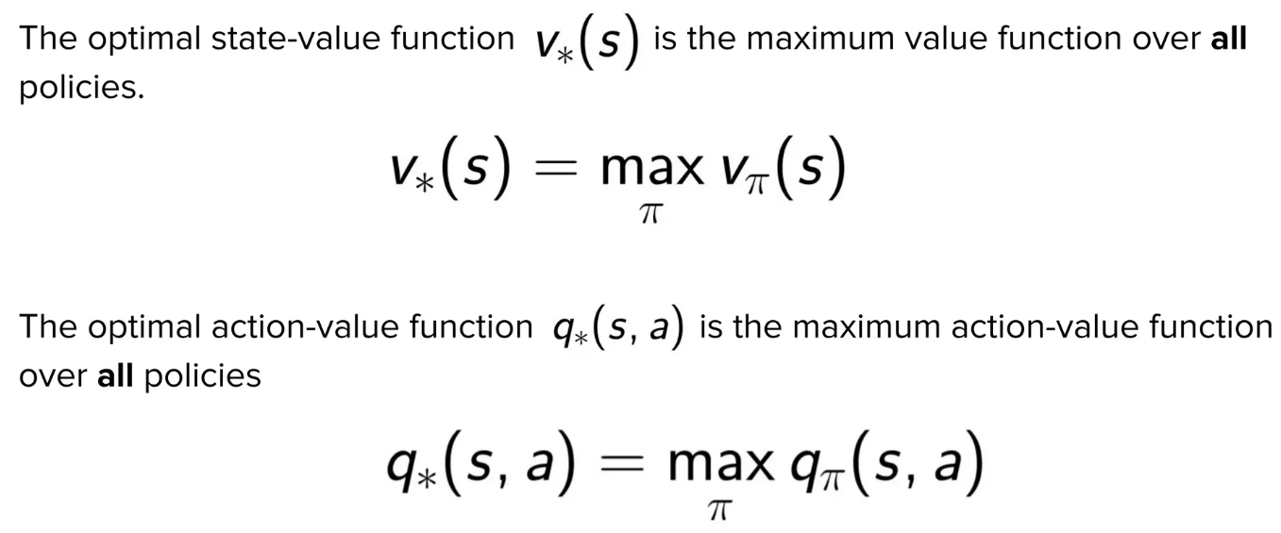
Optimal value and q functions

Slide 26
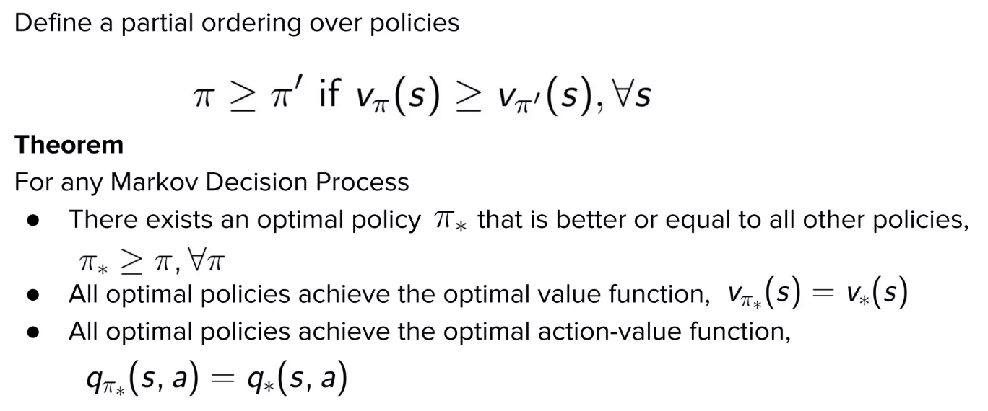
Optimal policy

Slide 27
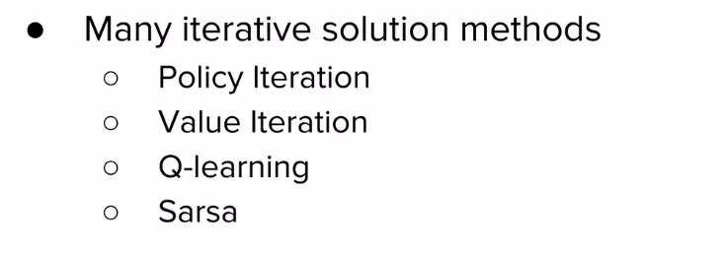
Policy optimization

Slide 28
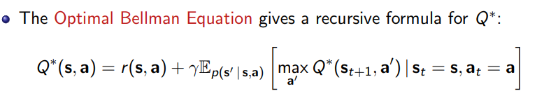
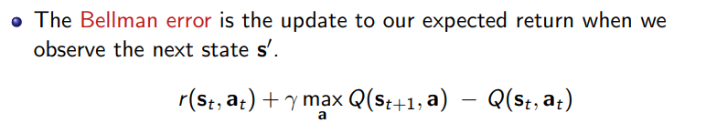
Q-Learning

Slide 29
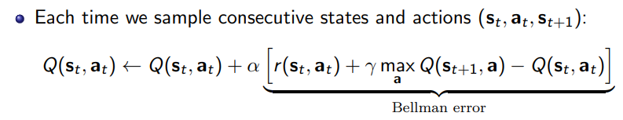
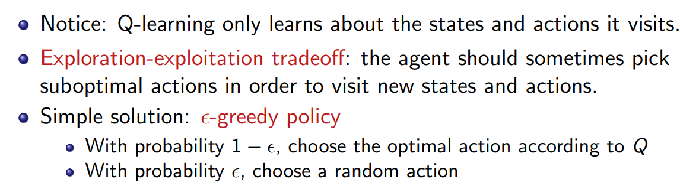
Q-Learning

Slide 30
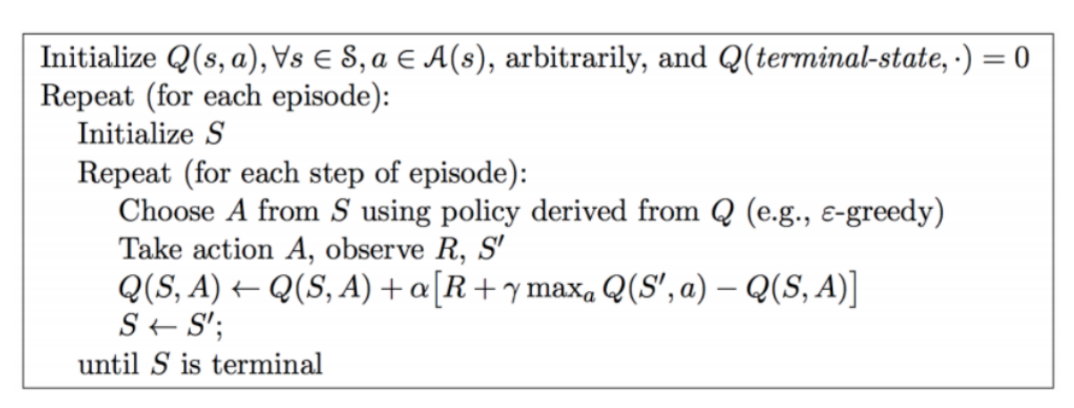
Q-Learning

Slide 31
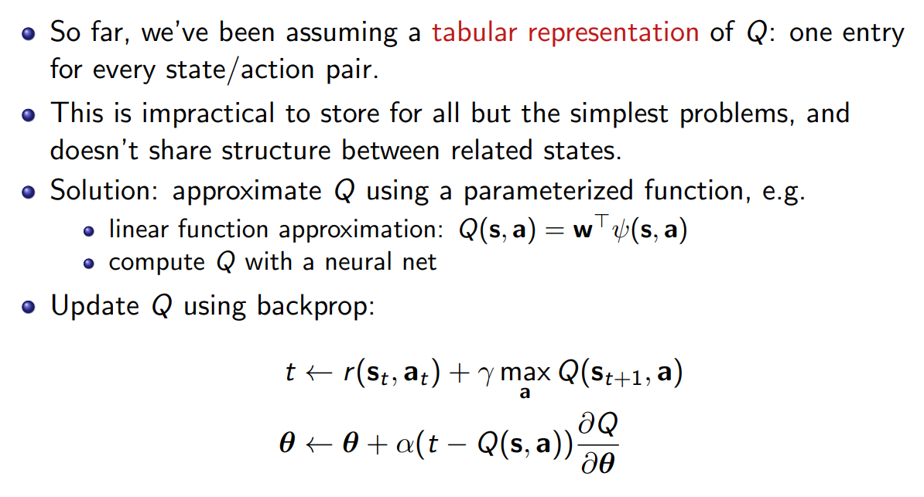
Deep Reinforcement Learning

Slide 32
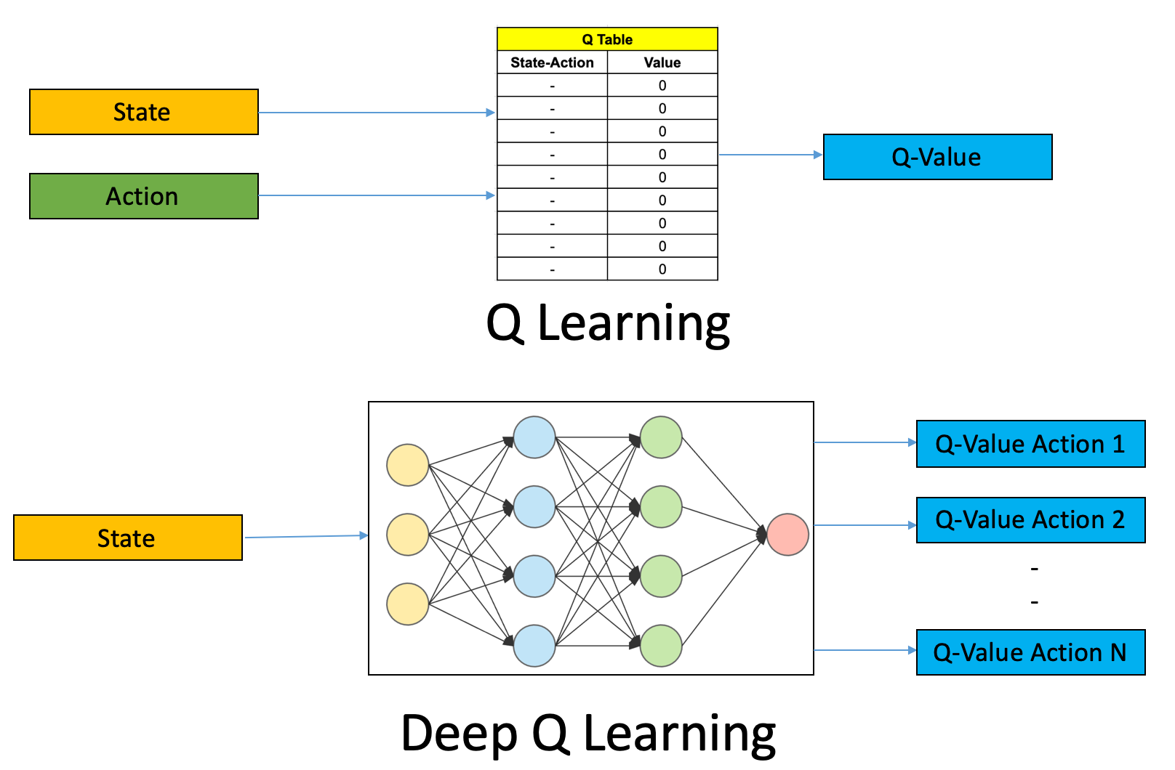
Deep Reinforcement Learning
Use Neural Network as Function Approximation

Slide 33
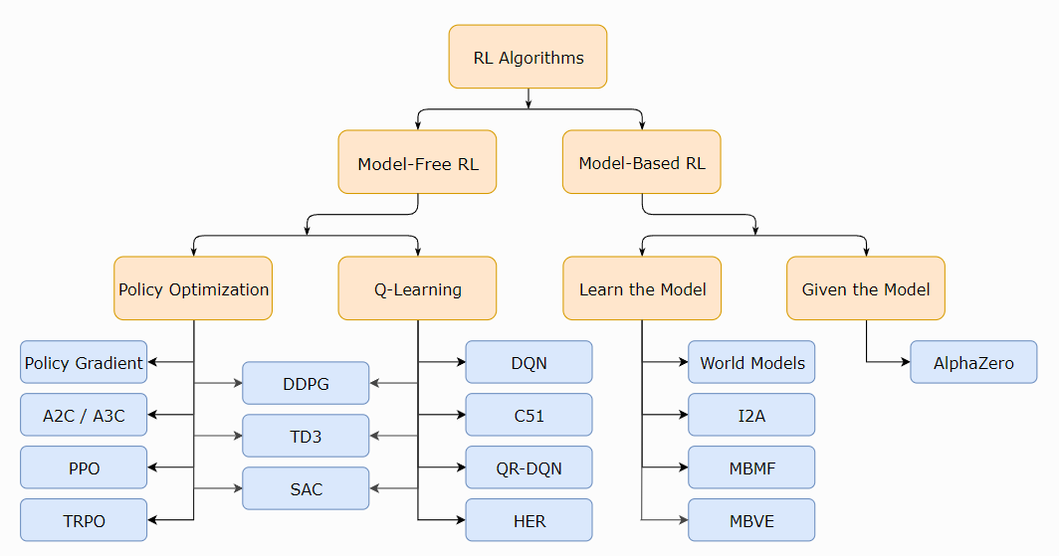
Deep Reinforcement Learning
Taxonomy
https://spinningup.openai.com/en/latest/spinningup/rl_intro.html
https://spinningup.openai.com/en/latest/spinningup/rl_intro2.html

Slide 34
Deep Q Network
Train a Neural Network to predict Q-Value for the environment.
Input: State
Output: Predicted Q-Function for actions
Take an action with max Q-Value
Loss:

Slide 35
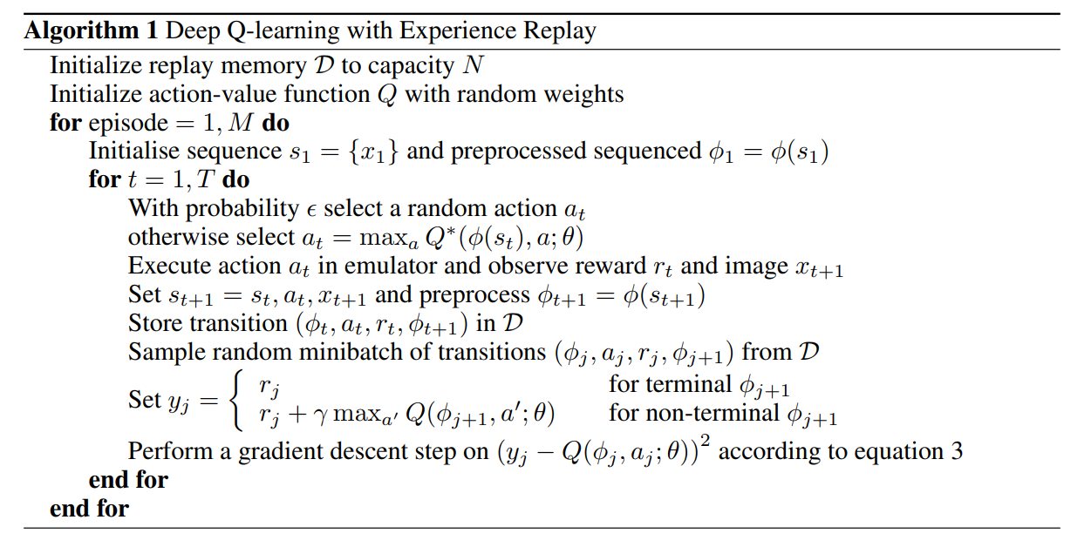
Deep Q Network (DQN)
https://www.cs.toronto.edu/~vmnih/docs/dqn.pdf

Slide 36
Materials and good slides
Levine slides:
https://rail.eecs.berkeley.edu/deeprlcourse/
RL concepts:
https://spinningup.openai.com/en/latest/spinningup/rl_intro.html
Big summary (ru):
https://arxiv.org/pdf/2201.09746 Pytorch good explanation: https://rail.eecs.berkeley.edu/deeprlcourse/deeprlcourse/static/slides/lec-3.pdf
Q-Learning https://www.cs.toronto.edu/~rgrosse/courses/csc421_2019/slides/lec21.pdf

Slide 37

Thank you for your attention!
www.ifmo.ru

